Slide 1


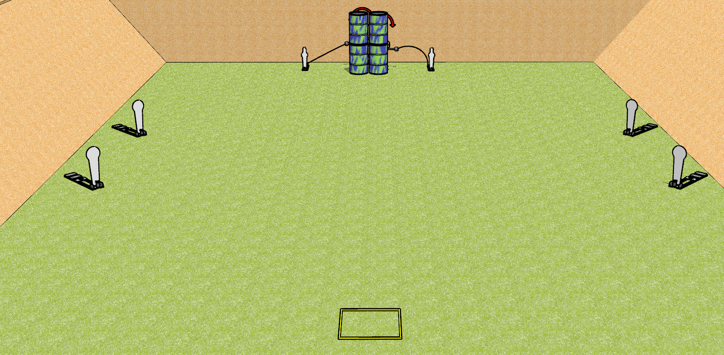
 | Dothan Gun Club – USPSA Match “Speed” shoot Course Designer : Drew Coleman
Round Count 8 rounds 2 IPSC targets 4 colt poppers, 2 USPSA mini poppers
Equipment List 2 swingers + activators Shooting box

Slide 2
“Speed” Shoot
Written Stage Briefing
“Speed” Shoot is an 8 round, 40 point, Comstock speed shoot. There are 2 IPSC targets, 4 colt poppers, and 2 USPSA mini poppers. The best 1 hit on paper will score, and steel must fall to score. The start signal is audible.
The left swinger is activated by the left mini popper, and the right swinger is activated by the right mini popper. Please check the activators prior to walkthrough and set them the same way every time.
Handgun start position is in shooting box, wrists below belt. Handgun is loaded and holstered.
PCC start position is in shooting box. Loaded carbine is held with both hands, stock on belt, safety on.
On start signal, engage targets as they become available from within the shooting area.

Slide 3
 | Dothan Gun Club – USPSA Match “Speed” shoot Course Designer : Drew Coleman
Round Count 10 rounds 2 IPSC targets 4 colt poppers, 2 USPSA mini poppers
Equipment List 2 swingers + activators Shooting box

Slide 4
“Speed” Shoot
Written Stage Briefing
“Speed” Shoot is an 10 round, 50 point, Comstock speed shoot. There are 2 IPSC targets, 4 colt poppers, and 2 USPSA mini poppers. The best 2 hits on paper will score, and steel must fall to score. The start signal is audible.
The left swinger is activated by the left mini popper, and the right swinger is activated by the right mini popper. Please check the activators prior to walkthrough and set them the same way every time.
Handgun start position is in shooting box, wrists below belt. Handgun is loaded and holstered.
PCC start position is in shooting box. Loaded carbine is held with both hands, stock on belt, safety on.
On start signal, engage the colt poppers or the mini poppers, then perform a mandatory reload and engage the remaining array. The paper may be engaged at any time.

Slide 5
 | Dothan Gun Club – USPSA Match “Speed” shoot Course Designer : Drew Coleman
Round Count 10 rounds 2 IPSC targets 4 colt poppers, 2 USPSA mini poppers
Equipment List 2 swingers + activators Shooting box

Slide 6
“Speed” Shoot
Written Stage Briefing
“Speed” Shoot is an 10 round, 50 point, Comstock speed shoot. There are 2 IPSC targets, 4 colt poppers, and 2 USPSA mini poppers. The best 2 hits on paper will score, and steel must fall to score. The start signal is audible.
The left swinger is activated by the left mini popper, and the right swinger is activated by the right mini popper. Please check the activators prior to walkthrough and set them the same way every time.
Handgun start position is in shooting box, wrists below belt. Handgun is loaded and holstered.
PCC start position is in shooting box. Loaded carbine is held with both hands, stock on belt, safety on.
On start signal, from within the shooting area, engage the left poppers and swinger OR the right poppers and swinger, perform a mandatory reload, and engage the remaining array.

Slide 7
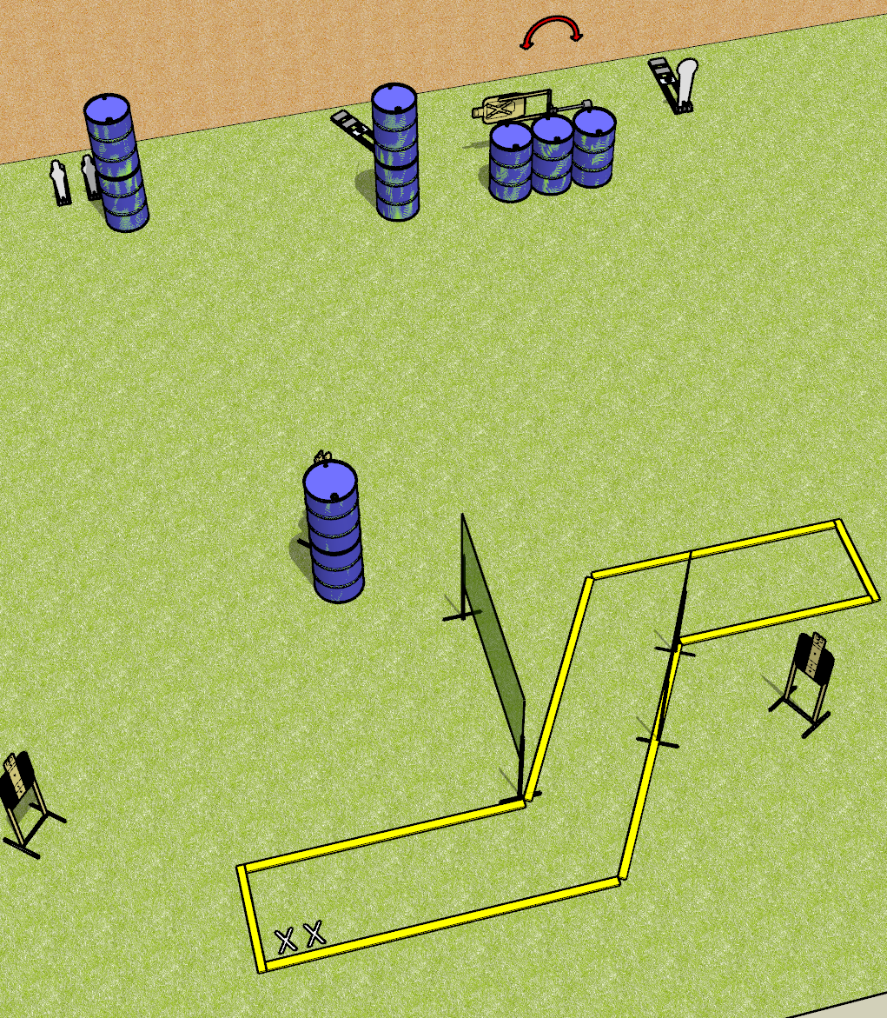
 | Dothan Gun Club – USPSA Match Canoe to Nowhere Course Designer : Drew Coleman
Round Count 12 rounds 4 paper 2 mini poppers and 2 Colt poppers
Equipment List 4 wall feet Swinger + activator 2 tuxedos

Slide 8
Canoe to Nowhere
Written Stage Briefing
Canoe to Nowhere is a 12 round, 60 point, Comstock short course. There are 4 USPSA targets, 2 Colt poppers, and 2 USPSA mini poppers. The best 2 hits on paper will score, and steel must fall to score. The start signal is audible.
The swinger is activated by the far right Colt popper. The swinger is not disappearing. Please check the activator prior to walkthrough and set it the same way every time.
Handgun start position is both feet on X’s, wrists below belt. Handgun is loaded and holstered.
PCC start position is both feet on X’s. Loaded carbine is held with both hands, stock on belt, safety on.
On start signal, engage targets as they become available from within the shooting area.

Slide 9
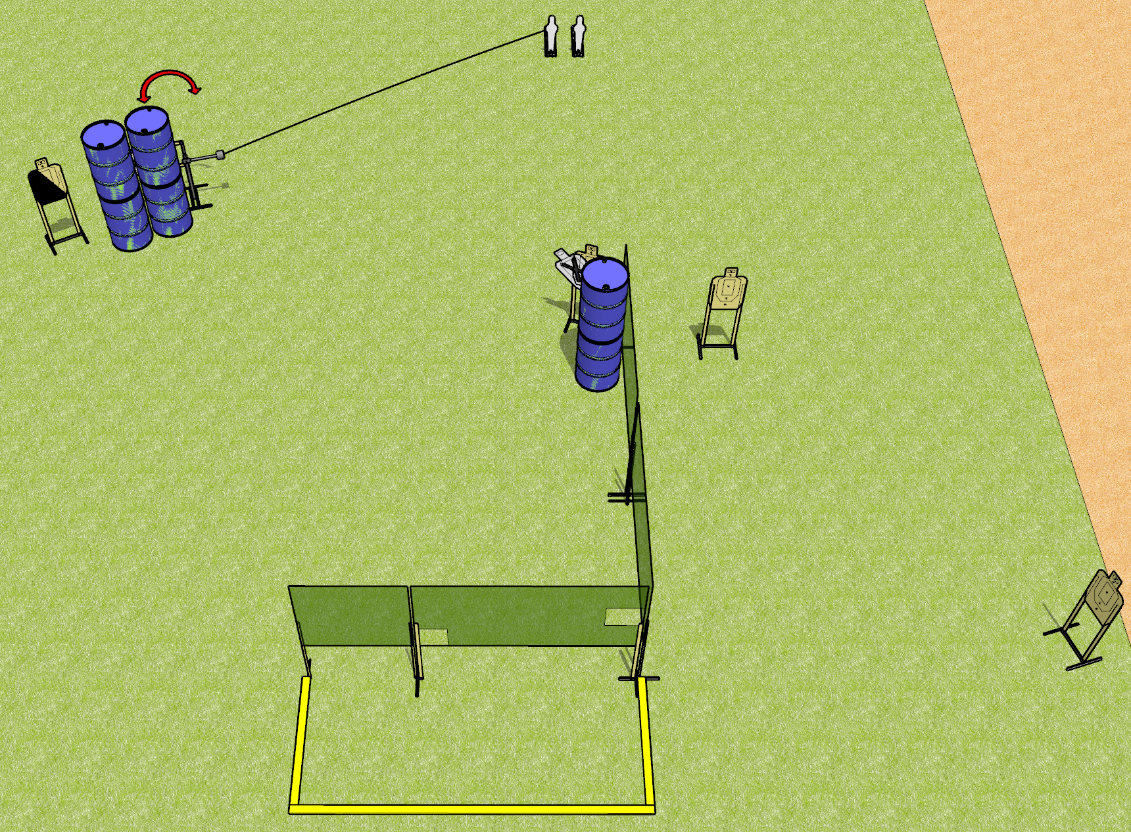
 | Dothan Gun Club – USPSA Match Three is Mean Course Designer : Drew Coleman
17 rounds 5 USPSA targets 2 USPSA mini poppers
Equipment List 5 wall feet Swinger + activator 1 diagonal HC

Slide 10
Three is Mean
Written Stage Briefing
Three is Mean is a 17 round, 85 point, Comstock medium course. There are 5 USPSA targets and 2 USPSA mini poppers. The best 3 hits on paper will score, and steel must fall to score. The start signal is audible.
The swinger is activated by the left mini popper. Please check the activator prior to walkthrough and set it the same way every time.
Handgun start position is anywhere outside the shooting area, wrists below belt. Handgun is loaded and holstered.
PCC start position is anywhere outside the shooting area. Loaded carbine is held with both hands, stock on belt, safety on.
On start signal, engage targets as they become available from within the shooting area. Perform a mandatory reload prior to the last shot fired. Failure to perform a mandatory reload prior to last shot will result in a procedural penalty.

Slide 11
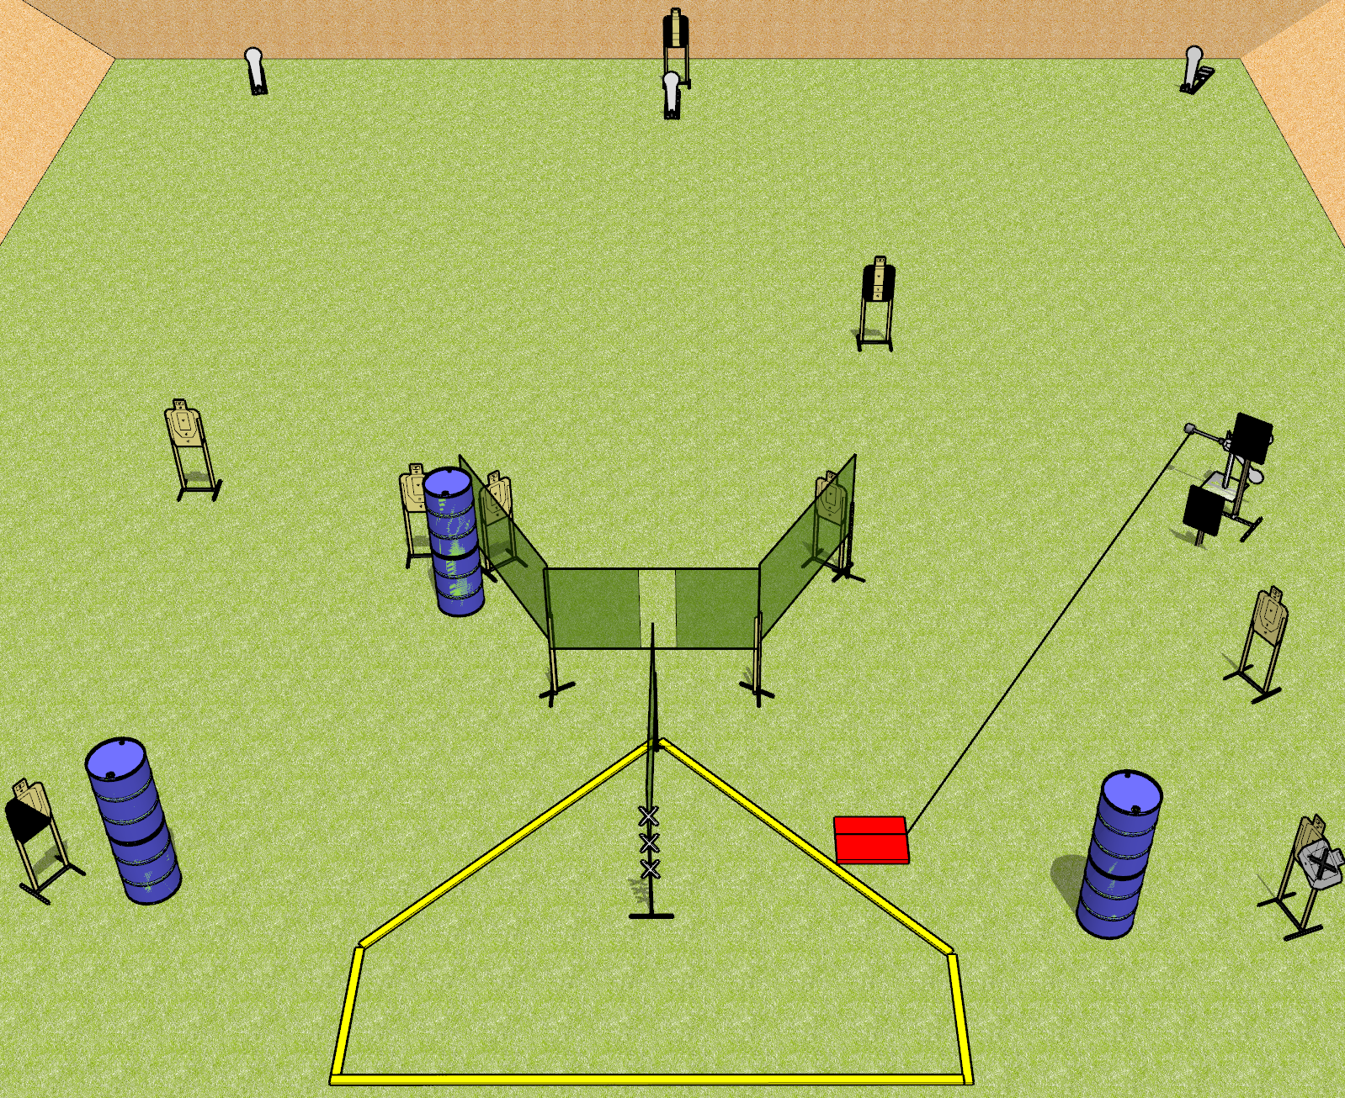
 | Dothan Gun Club – USPSA Match Hit the Plate Course Designer : Drew Coleman
Round Count 23 rounds 9 USPSA targets 3 colt poppers, 2 falling plates
Equipment List 8 wall feet Red stitch target Stomp box 2 18x24 plates + stands 2 tuxedos, 1 diagonal

Slide 12
Hit the Plate
Written Stage Briefing
Hit the Plate is a 23 round, 115 point, Comstock field course. There are 9 USPSA targets, 3 colt poppers, and 2 falling plates. The best 2 hits on paper will score, and steel must fall to score. The start signal is audible.
The swinging plates are activated by the stomp box. Please check the activator prior to walkthrough and set the activator the same way every time.
Handgun start position is hands touching marks on wall. Handgun is loaded and holstered.
PCC start position is muzzle touching any mark on wall. Loaded carbine is held with both hands, stock on belt, safety on.
On start signal, engage targets as they become available from within the shooting area.

Slide 13
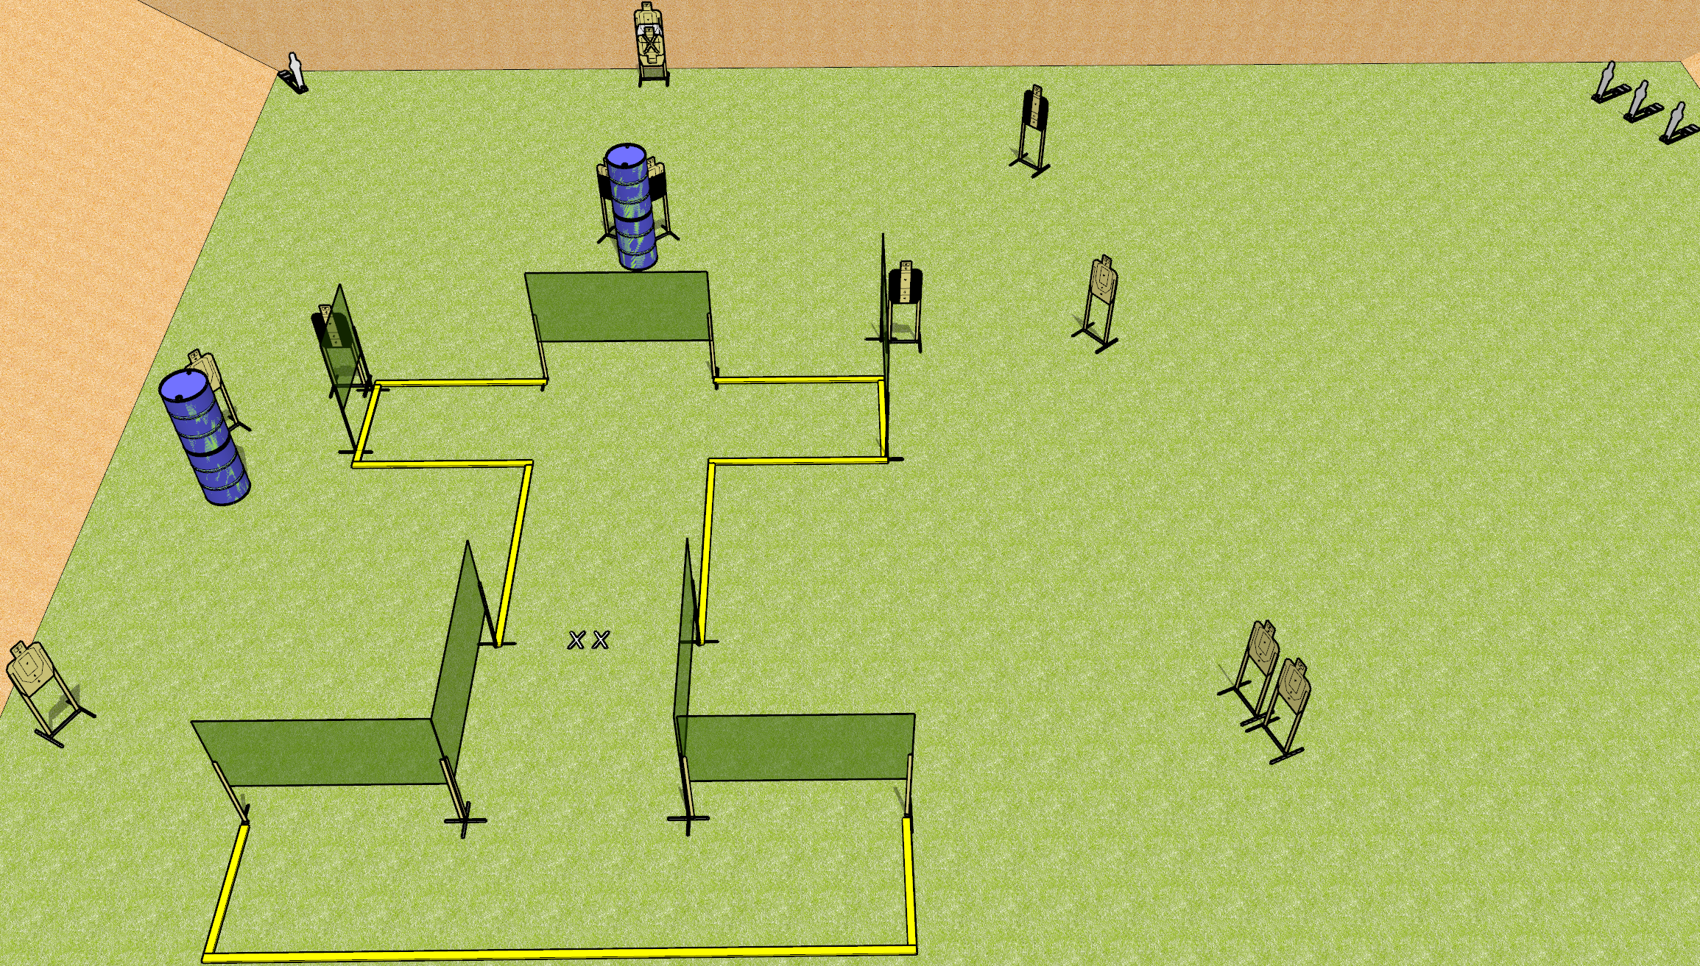
 | Dothan Gun Club – USPSA Match I Beam Course Designer : Drew Coleman
28 rounds 12 USPSA targets 4 USPSA mini poppers
Equipment List 12 wall feet 3 tuxedos, 2 50% OR use diagonal Target as the back is 2 stacked with NS

Slide 14
I Beam
Written Stage Briefing
I Beam is a 28 round, 140 point, Comstock field course. There are 12 USPSA targets and 4 USPSA mini poppers. The best two hits on paper will score, and steel must fall to score. The start signal is audible.
Handgun start position is both feet on X’s, wrists below belt. Handgun is loaded and holstered.
PCC start position is both feet on X’s. Loaded carbine is held with both hands, stock on belt, safety on.
On start signal, engage targets as they become available from within the shooting area.

Slide 15
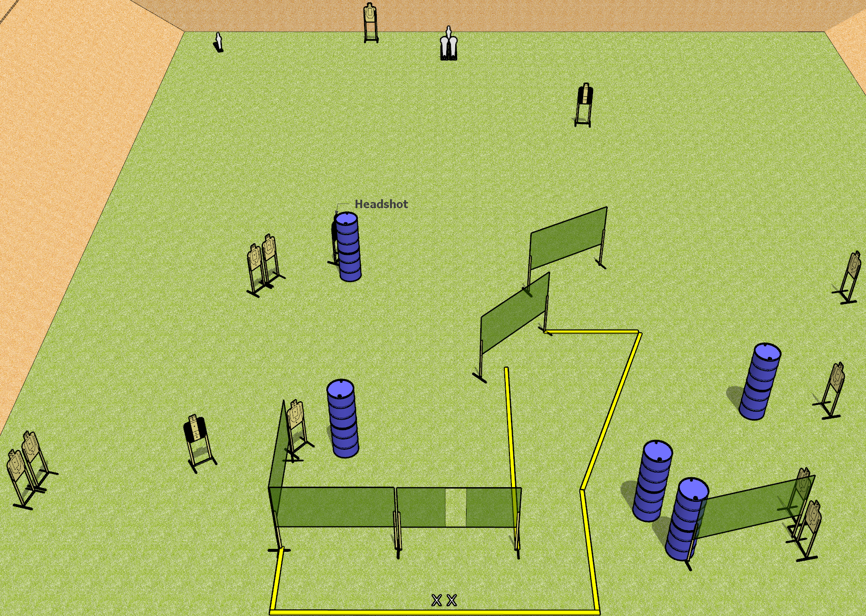
 | Dothan Gun Club – USPSA Match Rage Inducing Course Designer : Drew Coleman
Round Count 30 rounds 13 USPSA targets 2 colt poppers, 2 USPSA mini poppers
Equipment List 10 wall feet 2 Tuxedos, 1 headshot target

Slide 16
Rage Inducing
Written Stage Briefing
Rage Inducing is a 30 round, 150 point, Comstock field course. There are 13 USPSA targets, 2 colt poppers, and 2 USPSA mini poppers. The best 2 hits on paper will score, and steel must fall to score. The start signal is audible.
Handgun start position is both feet on X’s, wrists below belt. Handgun is loaded and holstered.
PCC start position is both feet on X’s. Loaded carbine is held with both hands, stock on belt, safety on.
On start signal, engage targets as they become available from within the shooting area.

Slide 17
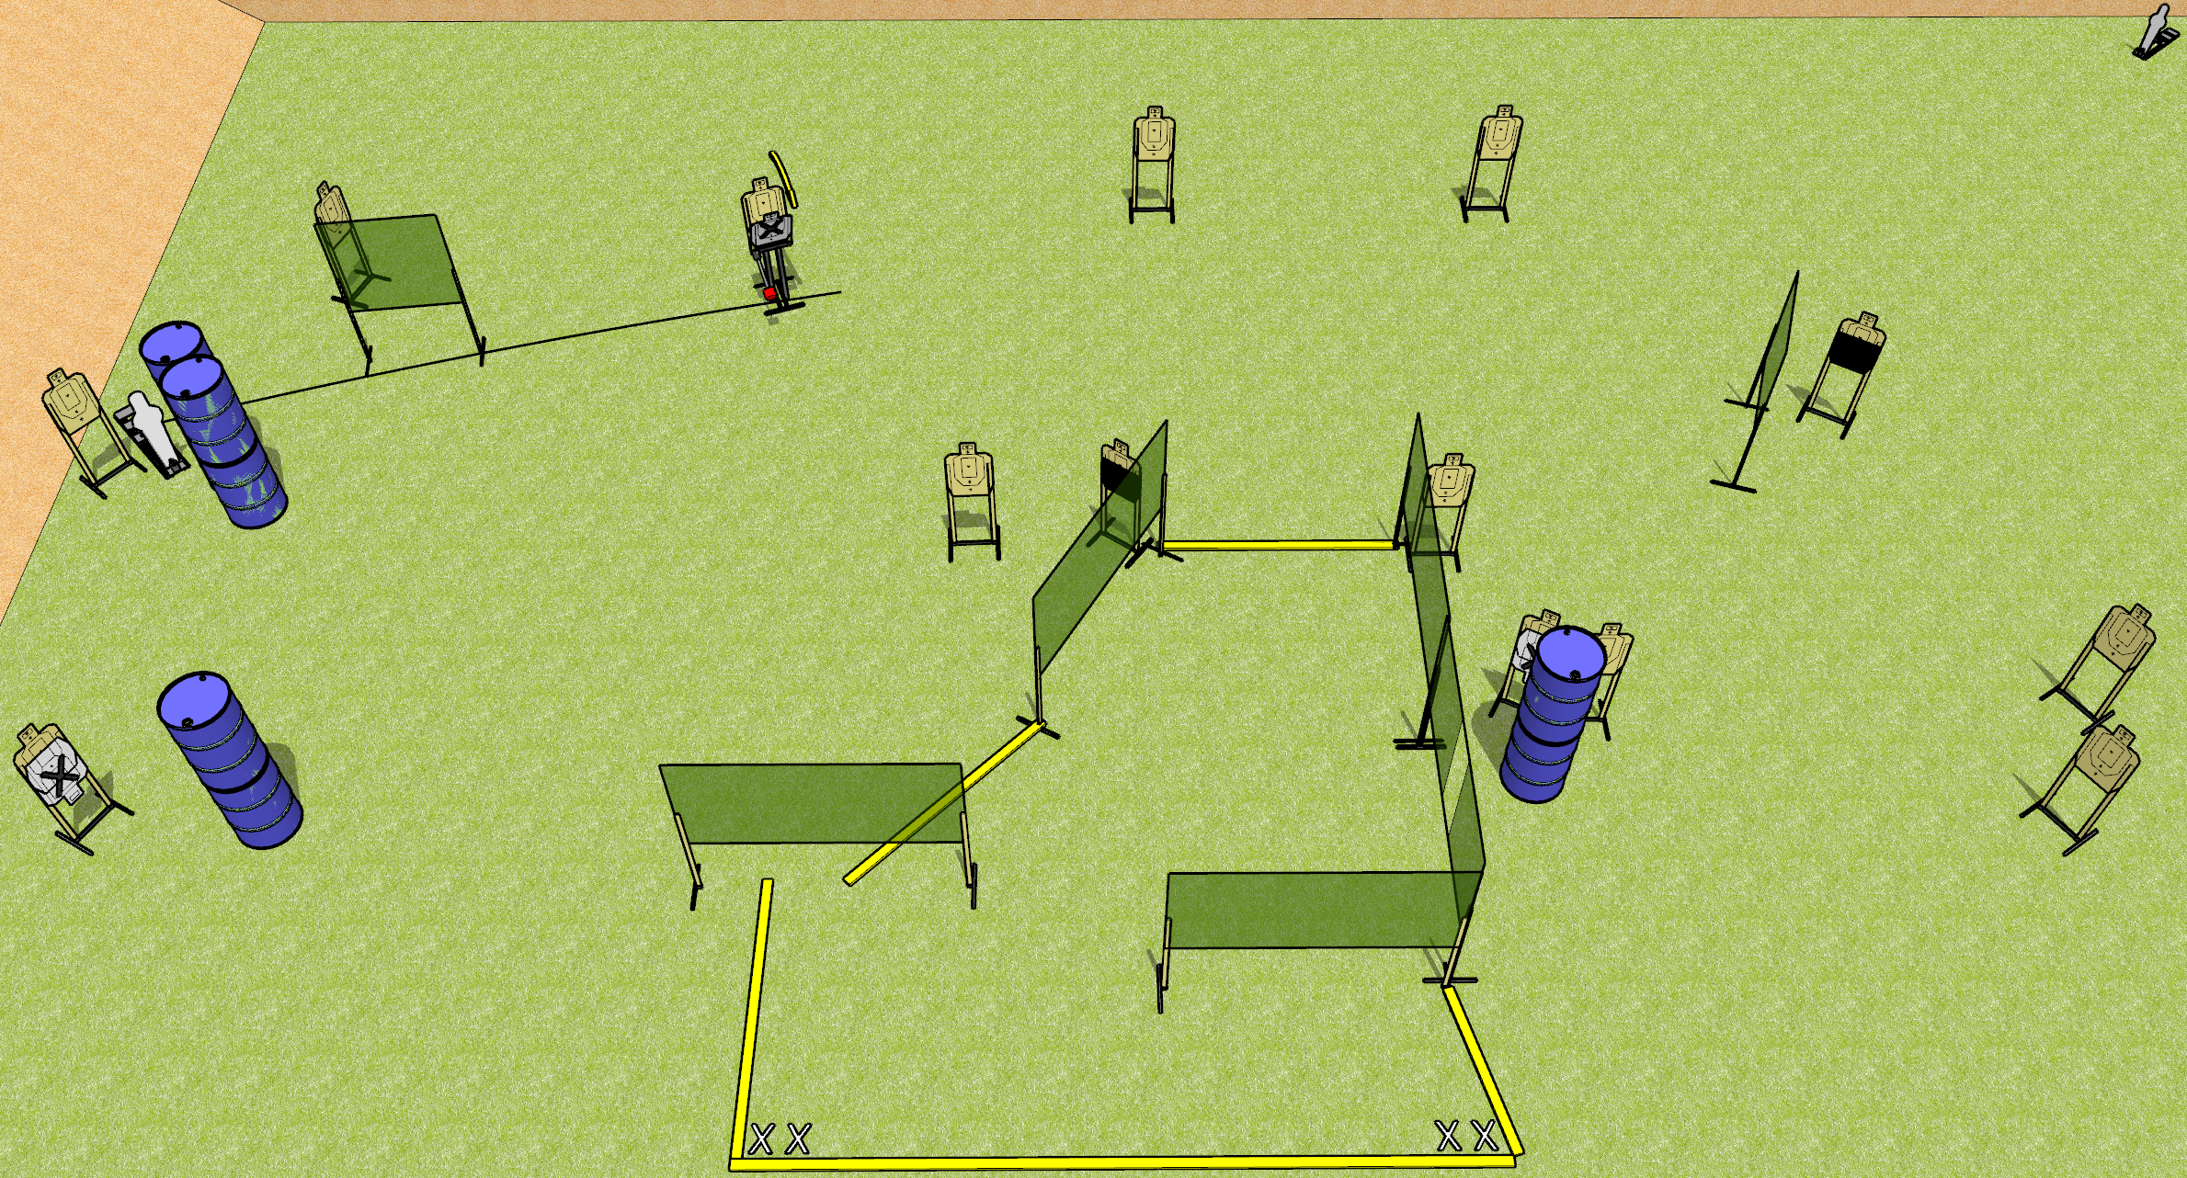
 | Dothan Gun Club – USPSA Match Mixtape Course Designer : Drew Coleman
30 rounds 14 USPSA 1 mini popper, 1 pepper popper
Equipment List 12 wall feet Max trap + activator 2 50% hard cover, consider mixing a tuxedo or 2 in SETUP NOTE: check stage flow and consider omitting the far-right small wall next to the hard cover

Slide 18
Mixtape
Written Stage Briefing
Mixtape is a 30 round, 150 point, Comstock field course. There are 14 USPSA targets, 1 pepper popper, and 1 USPSA mini popper. The best 2 hits on paper will score, and steel must fall to score. The start signal is audible.
The max trap is activated by the pepper popper, and is not a disappearing target. Please check the activator prior to walkthrough and set it the same way every time.
Handgun start position is both feet on either set of X’s, wrists below belt. Handgun is loaded and holstered.
PCC start position is both feet on either set of X’s. Loaded carbine is held with both hands, stock on belt, safety on.
On start signal, engage targets as they become available from within the shooting area.

Slide 19
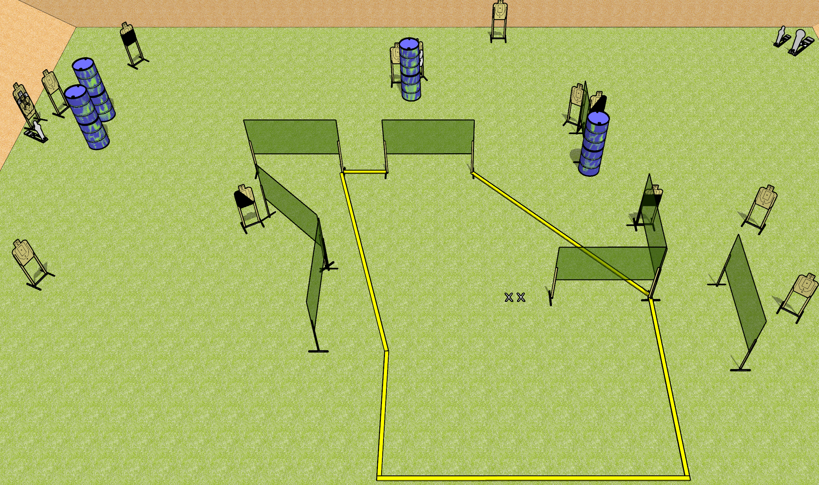
 | Dothan Gun Club – USPSA Match Big Chicken Course Designer : Drew Coleman
31 rounds 14 USPSA 1 colt popper, 2 mini poppers
Equipment List 15 wall feet 1 left and 1 right diagonal HC, 2 50% Far left target near mini popper is 2 + NS

Slide 20
Big Chicken
Written Stage Briefing
Big Chicken is a 31 round, 155 point, Comstock field course. There are 14 USPSA targets, 1 colt popper, and 2 USPSA mini poppers. The best 2 hits on paper will score, and steel must fall to score. The start signal is audible.
Handgun start position is both feet on X’s, wrists below belt. Handgun is loaded and holstered.
PCC start position is both feet on X’s. Loaded carbine is held with both hands, stock on belt, safety on.
On start signal engage targets as they become available from within the shooting area.

